Slide 1
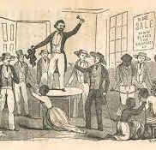
Understanding Slavery

Slide 2
Arrival of the European Traders
15th & 16th Centuries - European traders began Slave Trade.
European traders' previous interest in African nations & kingdoms (Ghana & Mali) was because of their trading networks. Traders then wanted to trade humans.
Europeans took enslaved people from Western Africa to Europe and the Americas.
Done firstly on a small scale – but grew in 17th – 18th Centuries - Europe conquered many of the Caribbean islands & much of North and South America.
Enslaved worked in mines & tobacco plantations in South America & sugar plantations in the West Indies.
Millions of Africans were enslaved and forced across the Atlantic to labour in plantations in the Caribbean & America.

Slide 3
Emergency of Slavery & Slave Trade
European slavery demanded large labour force:
People were captured & made slaves.
Enslaved Africans were transported huge distances to work & had no chance of returning home.
Children whose parents were enslaved became slaves as well.

Slide 4
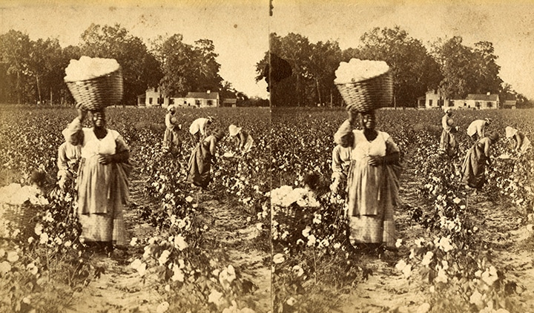
Slavery and the Plantation System
Slavery
System/condition in which individuals are owned by others and controlled to produce free labour. To be a slave is to be owned by another person.
Chattel Slave
An enslaved person who is owned forever & whose children and children's children are automatically enslaved.
Chattel slaves are individuals treated as complete property, to be bought and sold.
Chattel slavery was supported and made legal by European governments and monarchs. This type of enslavement was practiced in European colonies, from the sixteenth century onwards.
Slave Code:
Instituted the Slave Code first in Barbados in 1661;
Comprehensive law defining Africans as “heathens” and “brutes” not fit to be governed by the same laws as Christians;
Legislators defined Africans as non-human – forms of property to be owned by purchasers and their heirs forever.
Forms of slavery existed in Africa before Europeans arrived. Some countries in the African continent had their own systems of slavery. People were enslaved as punishment for a crime, payment for a debt or as a prisoner of war. However, African slavery was different from what was to come later.
Most enslaved people were captured in battle.
In some kingdoms, temporary slavery was a punishment for some crimes.
In some cases, enslaved people could work to buy their freedom.
Children of enslaved people did not automatically become slaves.

Slide 5
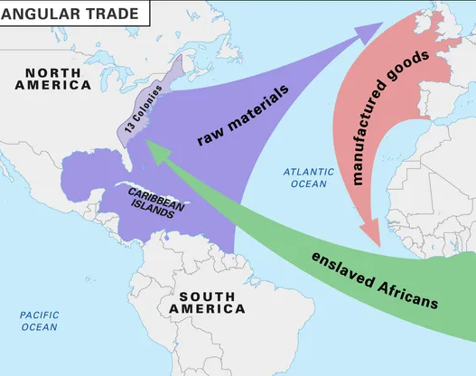
Transatlantic Slave Trade
Slave trade also known as Triangular Trade – three stages
The Middle Passage was the stage in the Atlantic Slave Trade where millions of enslaved Africans were transported to the Americas.

Slide 6
Stages of Slave Trade
Stage 1
Stage 1
Ships will leave Europe with goods for trade & sailed to Africa for trade – guns, alcohol, cloth
Stage 2
Stage 2
Africans were captured & sold to slave traders & shipped to the Americas ; Journey was known as Middle Passage since it reflected the middle of the journey.
Stage 3
Stage 3
Goods produced by the slaves were taken to Europe to be sold.

Slide 7
Stages of the Slave Trade
Stage 1
Stage 1
Slave ships from London, Liverpool & Bristol sailed to West Africa carrying goods -cloth, guns, ironware & alcohol made in Britain.
Later, on the West African coast, these goods would be traded for men, women and children who had been captured by slave traders or bought from African chiefs.
Stage 2
Stage 2
African dealers kidnapped villagers – attacking with pistols & threatened to kill those who did not obey.
Captives marched to coast & traded for goods; Forced to walk long distances – hands tied , behind their backs & necks connected by wooden yokes.
European traders bought people on African coast – separation of families.
Slaved held until arrival of ships; took a long time for filling of ship. Months sailing along the coast, looking for fittest & cheapest slaves.
‘Middle Passage – slaves were densely packed for voyage to West Indies.
Violent resistance by Africans to slave traders – revolts
Stage 3
Stage 3
Slaves sold to highest bidder In the West Indies.
Once purchased, enslaved Africans worked for free on plantations.
Became property of planation owners - had no rights & punished harshly.
Enslaved Africans resisted –revolution, running away & silent, personal resistance – taking their lives. Some pregnant women aborted.
Some slaves slowed the work pace - pretending illness, causing fires/ ‘accidentally' breaking tools.
2/3 slaves ended up on sugar plantations. Sugar was used to sweeten another crop harvested by enslaved Africans in the West Indies - coffee.
With the money made from the sale of enslaved Africans, goods such as sugar, coffee and tobacco were bought and carried back to Britain for sale.

Slide 8
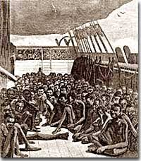
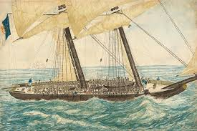
Middle Passage
Middle Passage –
refers to the part of the trade where Africans, densely packed onto ships, were transported across the Atlantic to the West Indies.
Voyage took 3-4 months & enslaved people mostly lay chained in rows on the floor of the hold or on shelves that ran around the inside of the ships' hulls.
Approximately more than 600 enslaved people on each ship. Captives from different nations were mixed - difficult to talk & plan rebellions.
Women and children were held separately.

Slide 9

The "Ark of Return", the permanent memorial to honour the victims of slavery and the transatlantic slave trade, located at the Visitors' Plaza of United Nations Headquarters in New York. 22 May 2015. UN Photo/Rick Bajornas

Slide 10
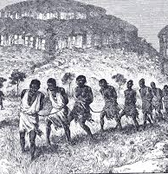
Capture & Enslavement
Warfare, Raids, Kidnapping, Judicial Injustices, debts unpaid
Slave Forts
Equipped with guns & cannons to defend European interest
Forts had narrow windowless stone dungeons for captured Africans
established along coast of West Africa to house captured slaves in holding pens – barracoons.
Forts were fought over by Portuguese, Dutch, & British
Principle Method was warfare, raids and kidnapping Africans from their villages

Slide 11
African Rulers & the Slave Trade
The British traders covered the West African coast from Senegal in the north to the Congo in the south; occasionally venturing to take slaves from South-East Africa in present day Mozambique.
Some African rulers fought against the slave trade. However, other African rulers were willing to supply European traders with the extra enslaved people they wanted. As demand grew, some African traders started to capture other Africans and sell them to the Europeans. The British, French and Portuguese often helped these rulers in wars against their enemies.
African rulers who supported European slave trade became very rich and powerful. The Europeans also equipped them with guns, thus the numbers of wars on the African Continent increased with more violence due to European guns and weapons. Many enslaved Africans died as a result of the wars.

Slide 12

Enslaved Africans Ethnic Composition
Igbos from Bight of Biafra – largest single ethnic group
Akan – Gold Coast
Bantu – Central Africa

Slide 13
Distribution of Africans to New World
West Indies 4,040,000
Brazil 3,847,000
Guiana 531,000
Spanish South America 522,000
North America 427,000
Mexico and Central America 224,000

Slide 14

Slavery was a form of capitalism in nature.
The late Dr. Eric Williams, the first Prime Minister of Trinidad and Tobago, in his book “Capitalism and Slavery” also highlighted the importance of slavery to the Europeans and said that slavery was driven by capitalism.

